Slide 1

AIRPORT
MANAGEMENT
SYSTEM
Apoorv Dhaygude dhaygude.a@northeastern.edu

Slide 2


OBJECTIVES
and GOALS
Effective Data Management
Implementing robust data infrastructure for tracking flights, passengers, and baggage
Enhanced Passenger Experience
Streamline check-in, baggage handling, and information services
Integrated Operation and Resource Efficiency
Ensuring smooth coordination in airports involves integrating various operations like baggage handling, security checks, passenger services, and flight operations.

Slide 3

Design
Considerations
and Approach
System Architecture
Centralized database for efficient airline and passenger data management.
Entities and Relationships
Key Entities - Employees, Airport, Passenger, Airline, Ticket, Baggage, Flight
Four associative entities - Baggage Tracking, booking, cancellation, and Immigration Clearance.
Scope and Assumptions
A city has a single major international airport
Exclusive analysis of international flights

Slide 4
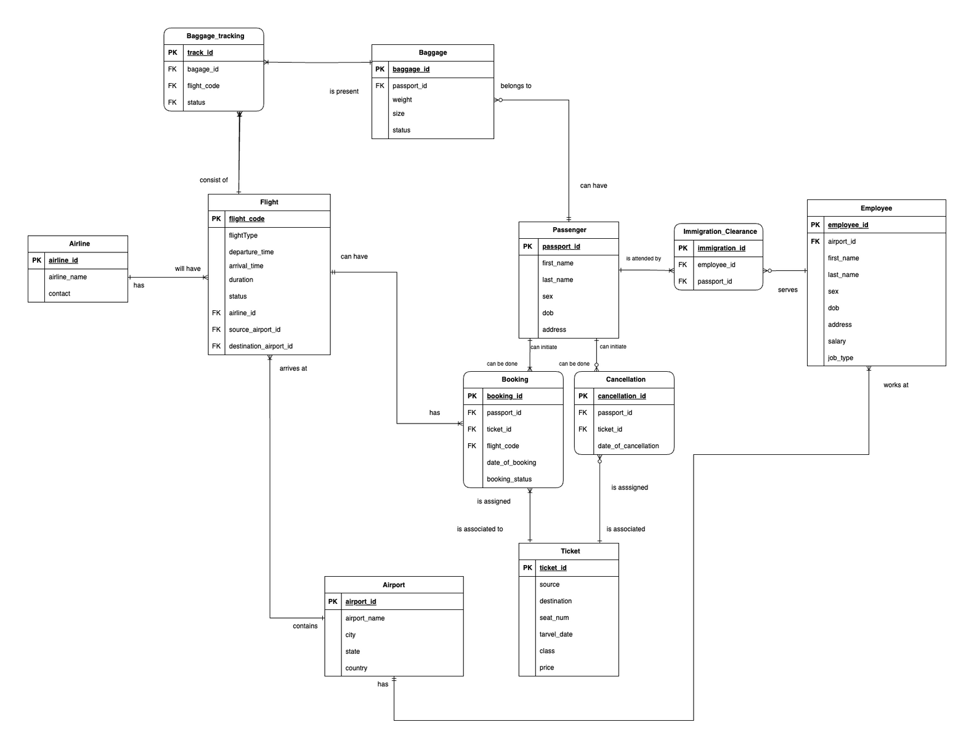

Entity- Relation Diagram (ERD)

Slide 5
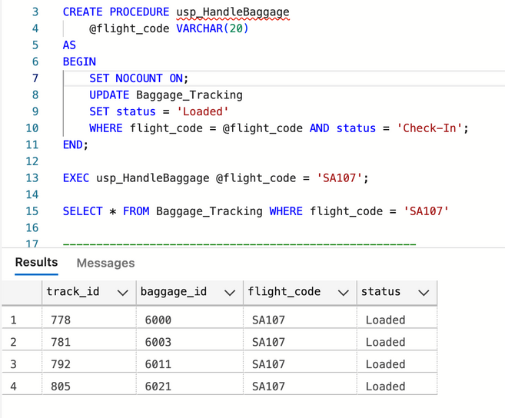
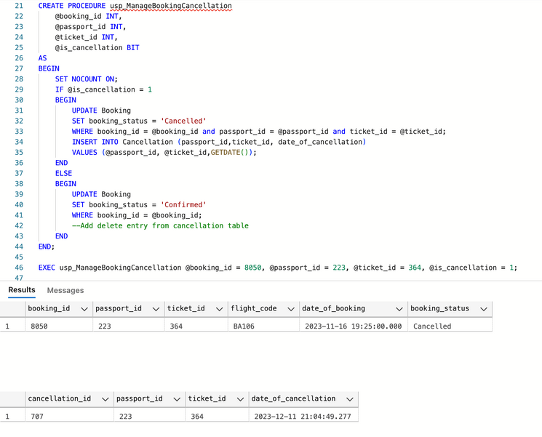
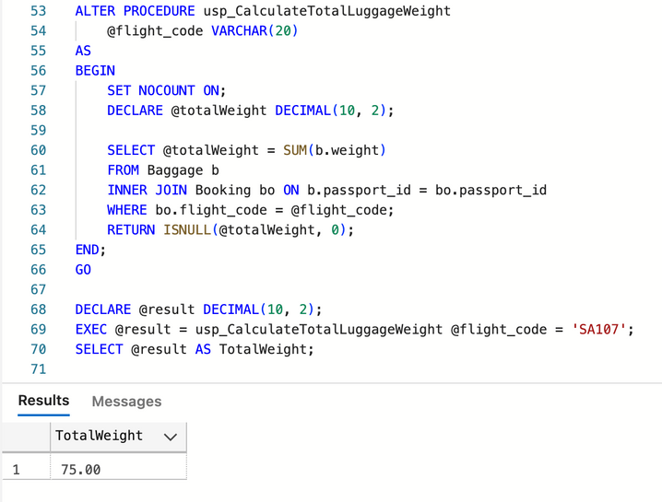
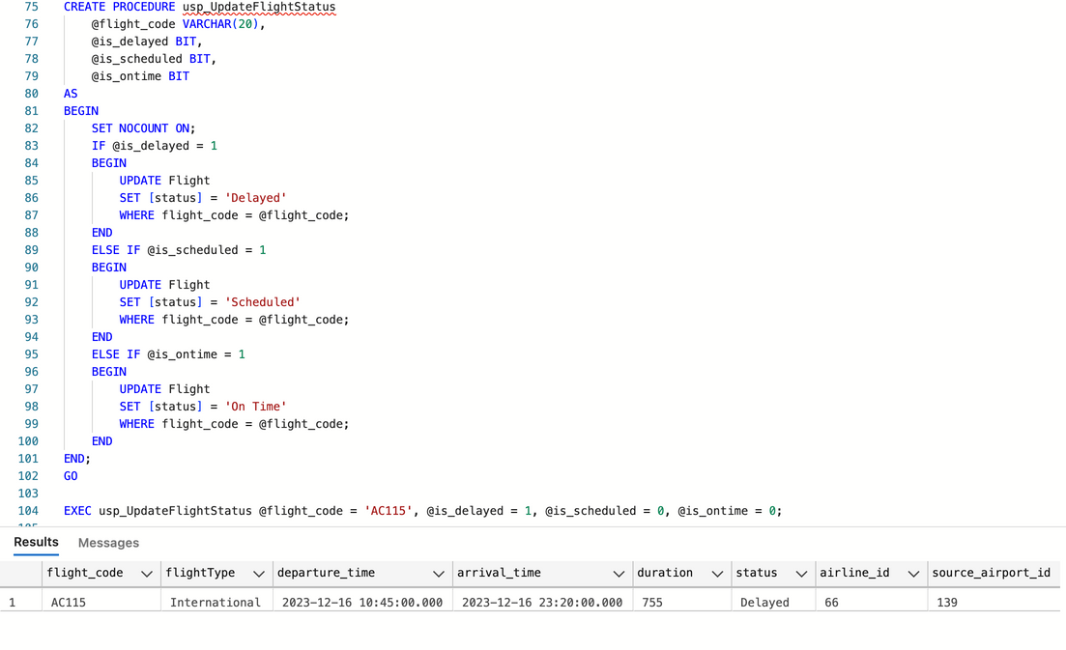
Stored Procedures
Handle Baggage
Manage Booking Cancellation
Calculate Luggage Weight for the Flight
Update Flight Status

Slide 6
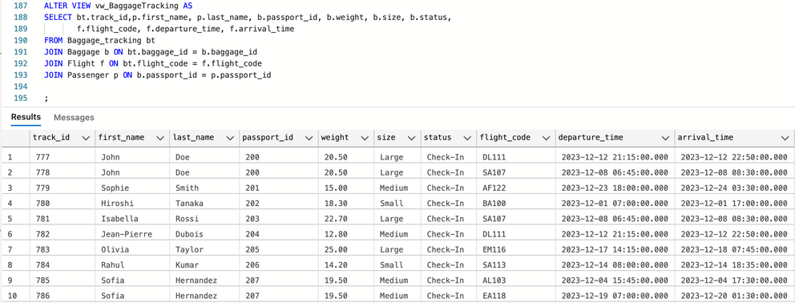
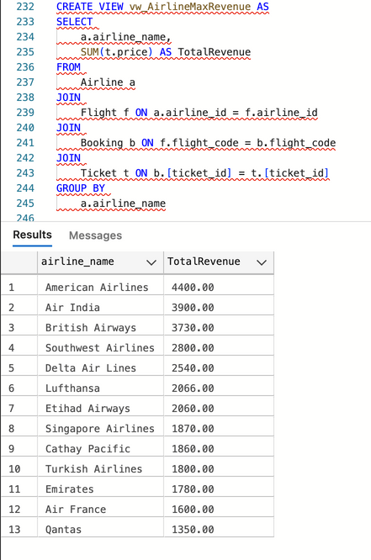
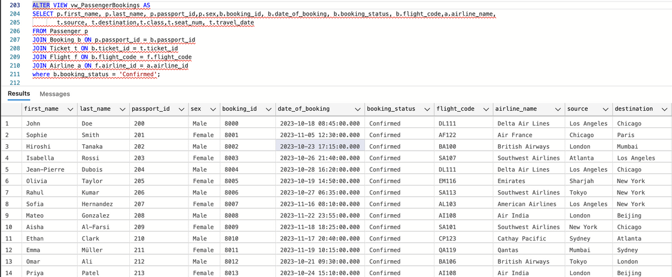
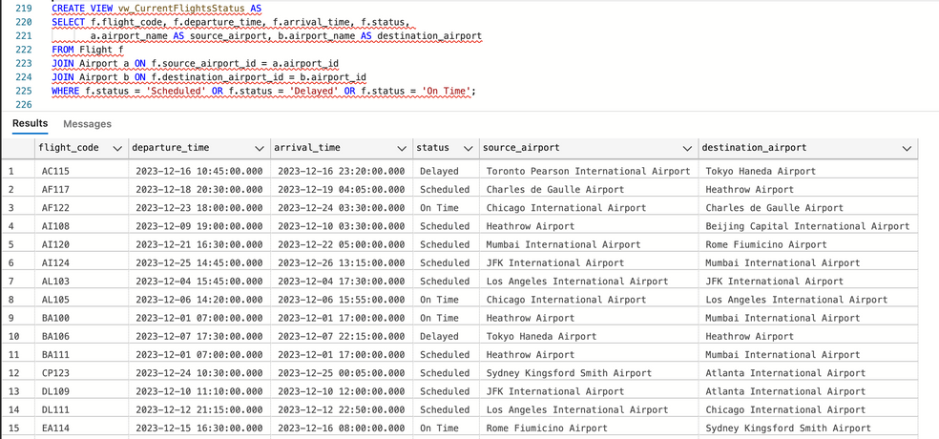
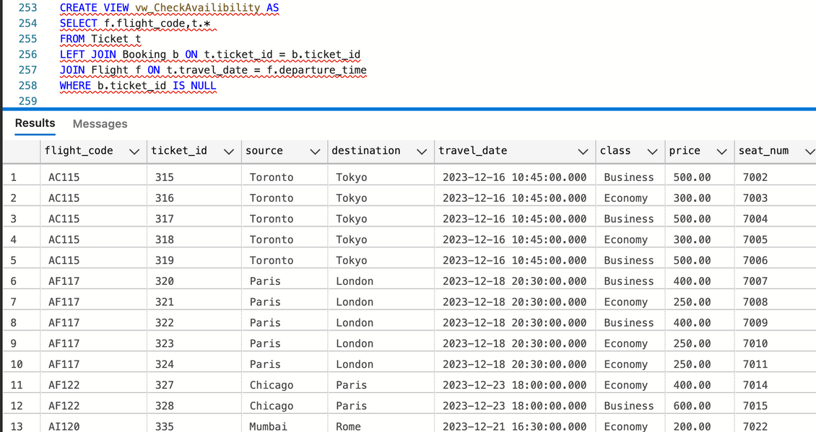
Views
Baggage Tracking
Airline Revenue
Passenger Bookings
Current Flight Status
Checking Ticket Availability

Slide 7
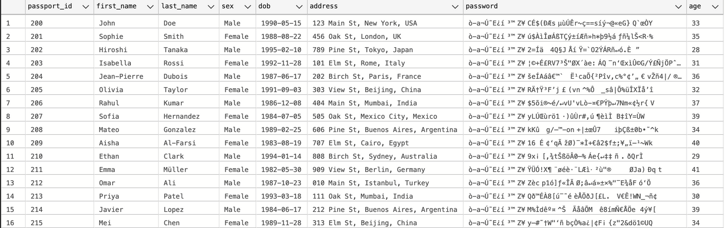
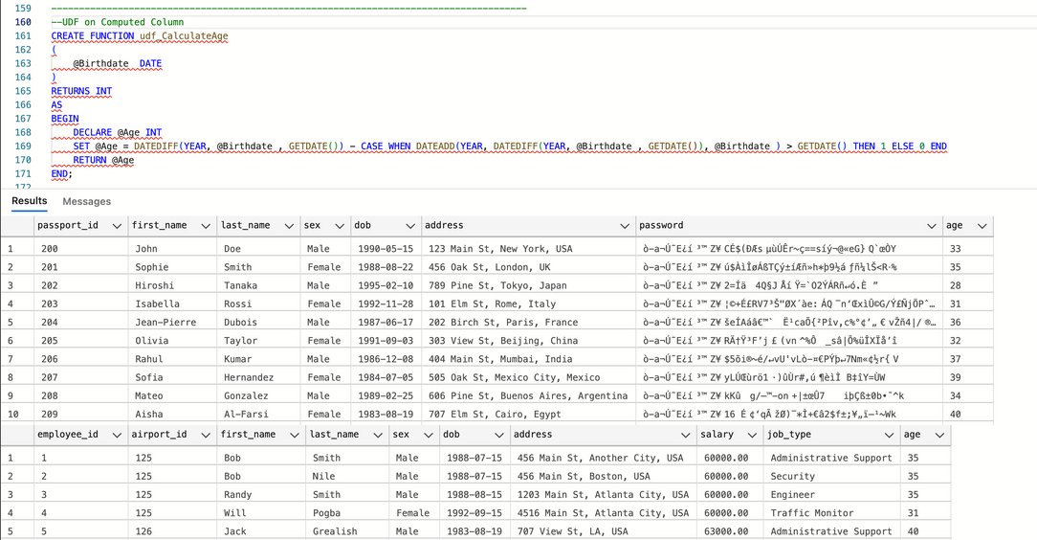
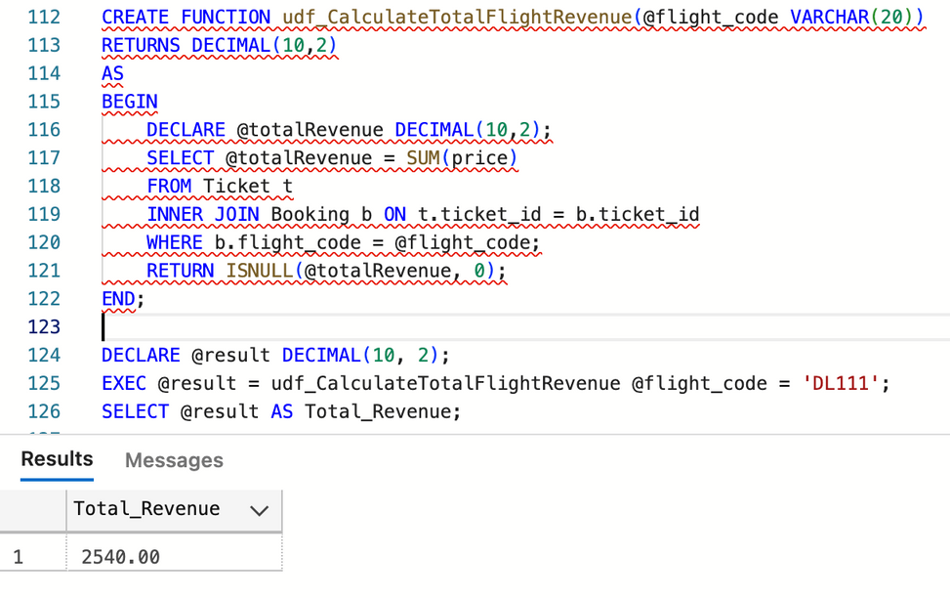
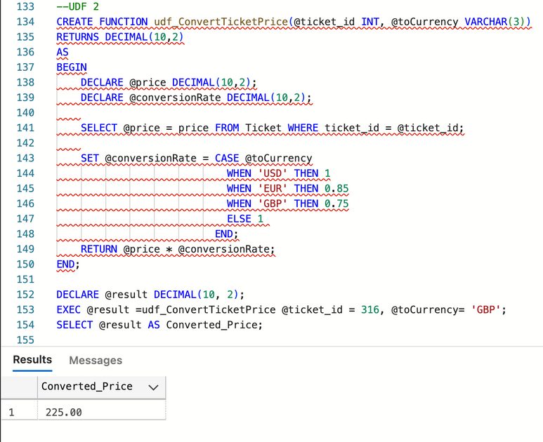
UDF and Encryption
Encryption on Password
UDF on Computed Column
Calculate Total Flight Revenue
Convert Ticket Price

Slide 8
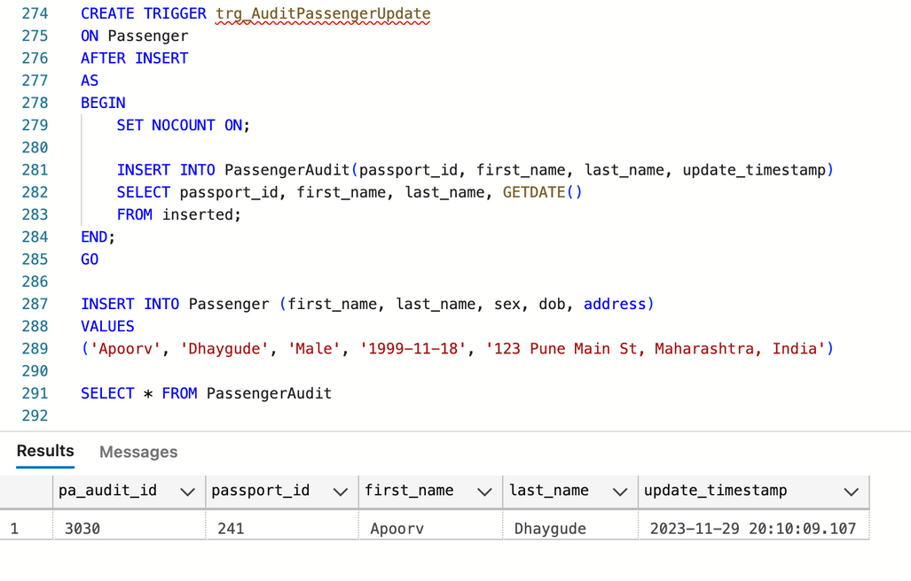
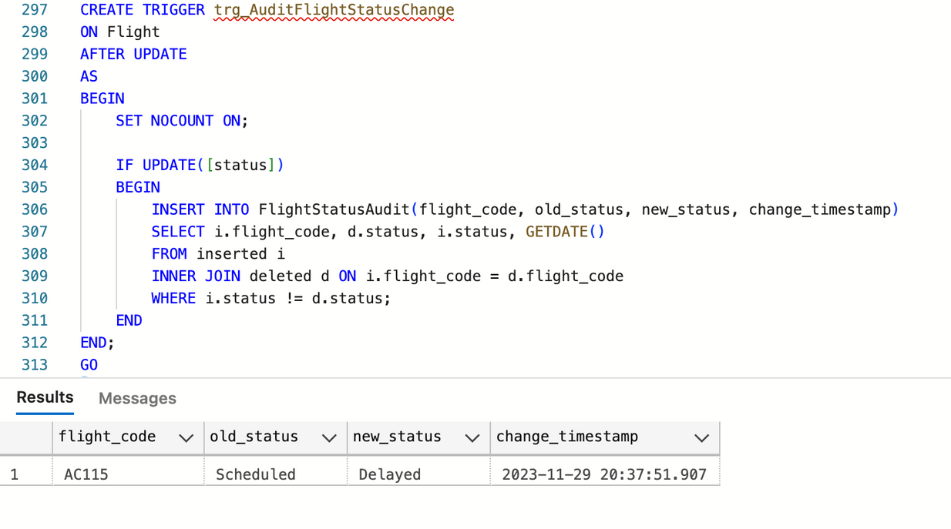
Triggers
Trigger for Passenger Insertion
Trigger for Flight Status Change

Slide 9
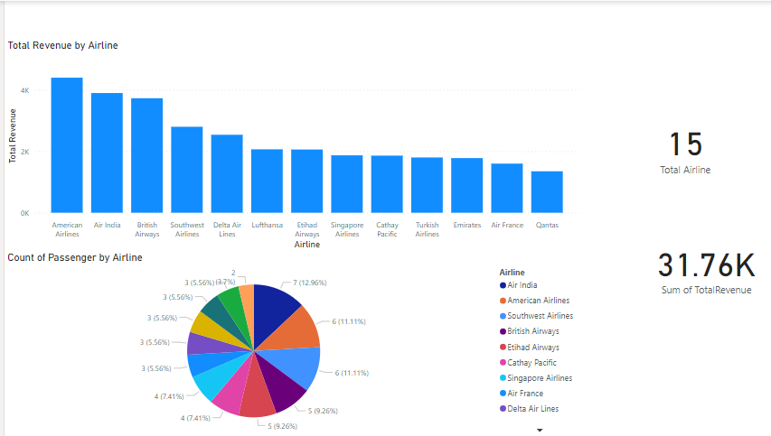
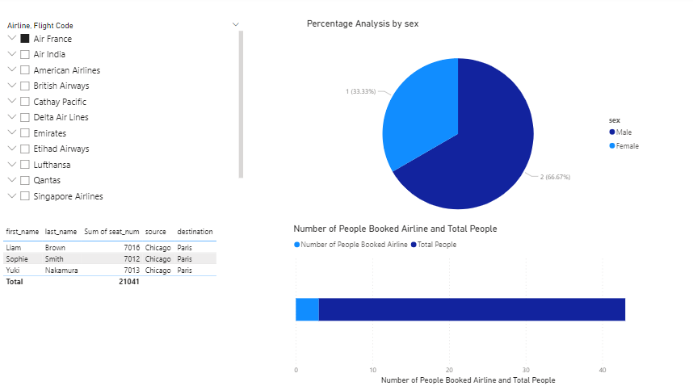
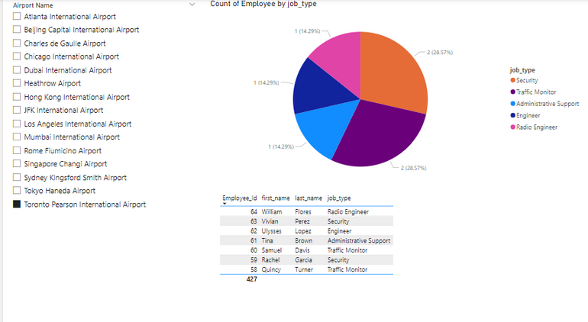
Visualization - Power BI
Revenue Analysis : Airline
Passenger Booking
Airport - Employee Association

Slide 10
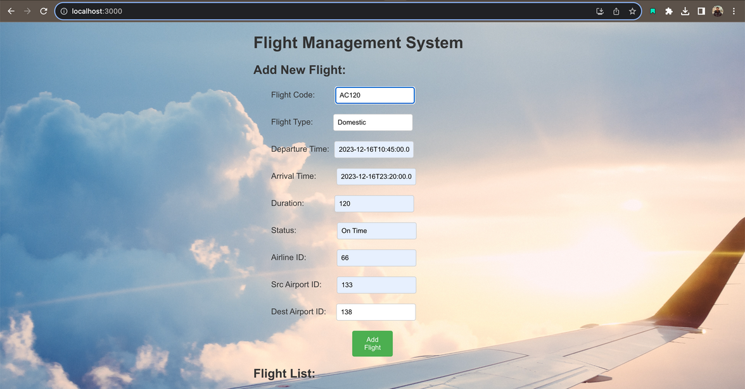
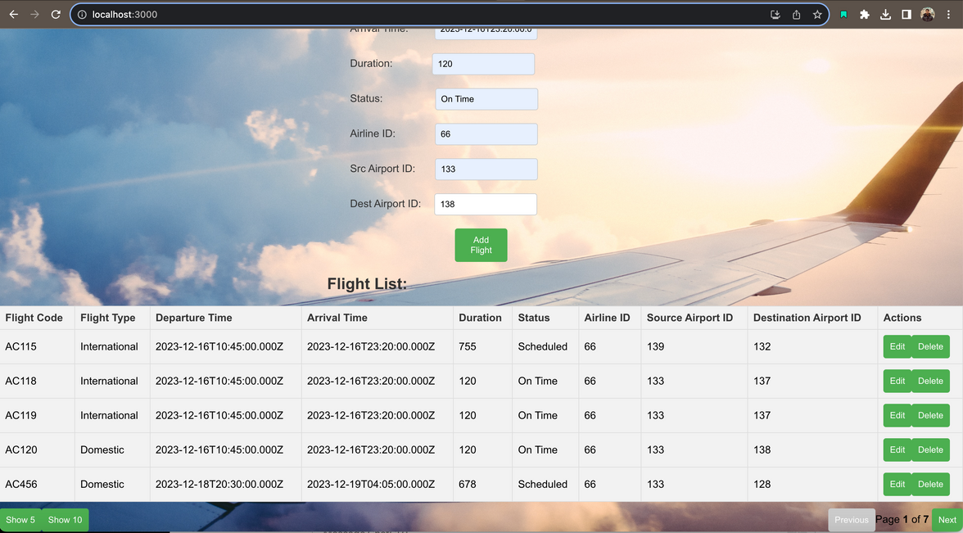
GUI
CRUD Operations

Slide 11

THANK YOU

